Slide 1
Which Ending Mark do I Need?
Read each sentence.
Decide if it is:
an asking sentence or question,
a telling sentence or statement,
a command,
or an exclamation.
Decide which punctuation is needed to complete the sentence.
Then act it out!!!

Slide 2
Walk in the hallway

Slide 3
I hate pickles

Slide 4

Who is your best friend

Slide 5

I like to read books by Dr. Seuss

Slide 6
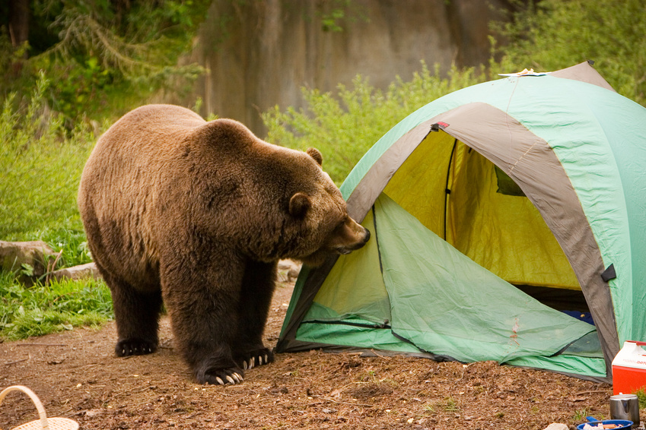
Run for your life

Slide 7

Open your book to page 10

Slide 8
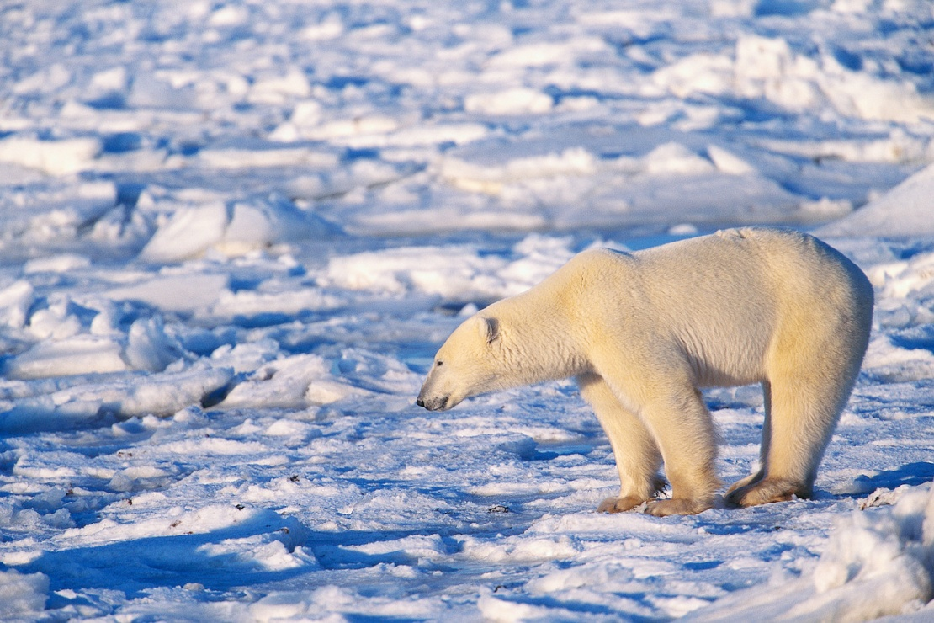
Polar bears are white, and they live in the Arctic

Slide 9
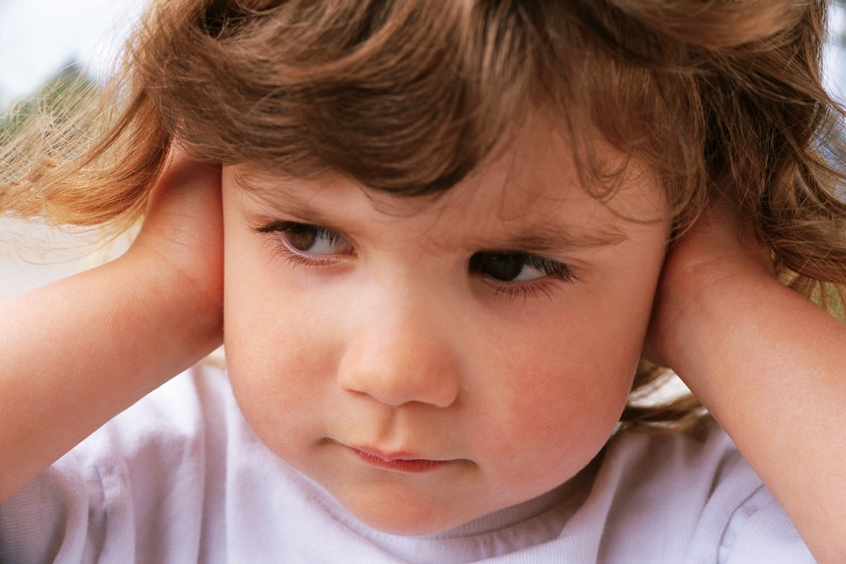
It is way to loud

Slide 10
Where did you put your homework

Slide 11
I hope you have sweet dreams

Slide 12
Brush your teeth and go to bed

Slide 13
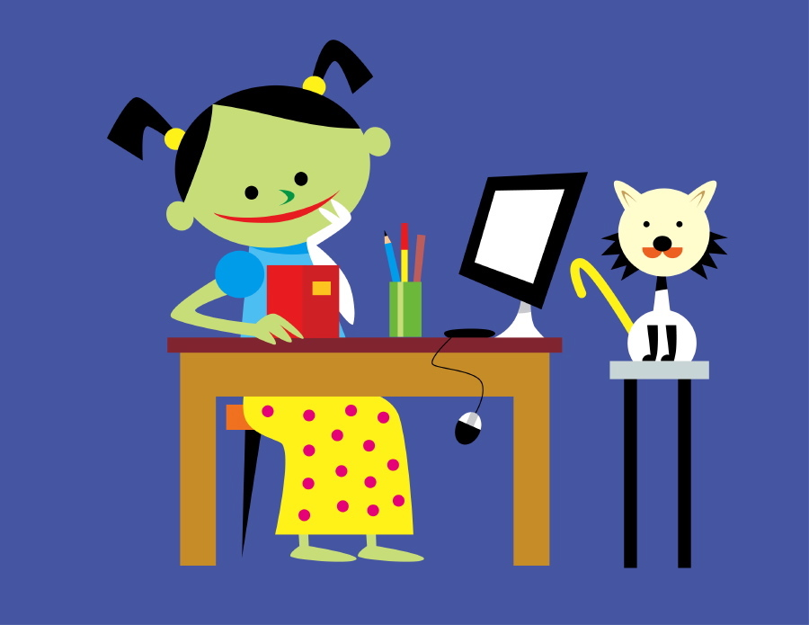
Who wrote that chapter book

Slide 14
Great job with your sentences

